Slide 1
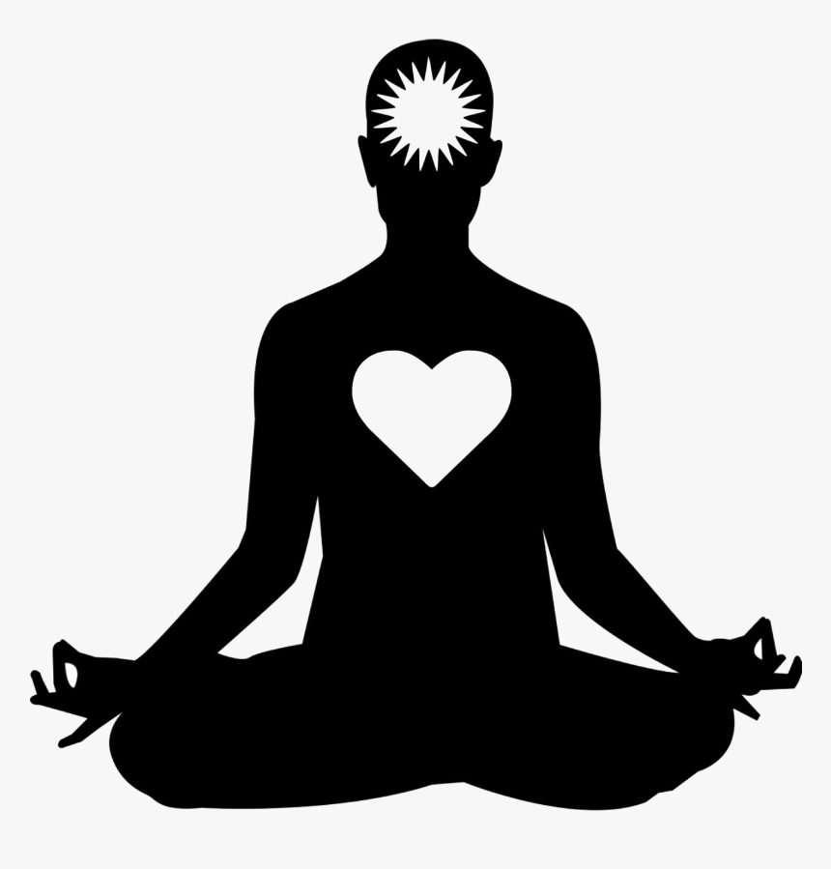
Yoga For Health

Slide 2
Contents
History of Yoga ?
What is Yoga ?
Advantages of Yoga ?
Yoga Purpose ?
Benefits of Yoga ?
Yoga Techniques ?
Asana(Body Posture)
Shatkarmas
Mudhras
Accupressure points
Conclusion

Slide 3
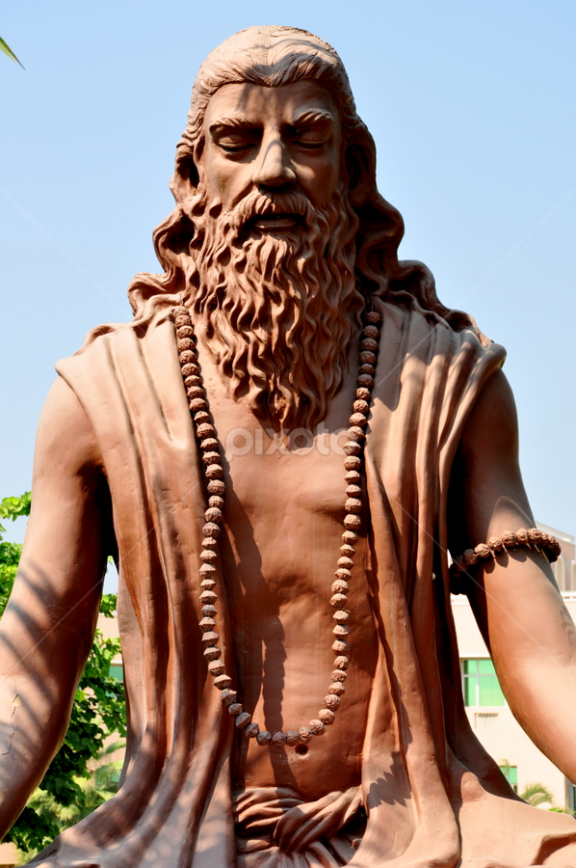
History of Yoga
Yoga is originated from Veda, Oldest Scripture of india(400 B.C) and systematically presented by Sage Patanjali in Yogasutra in around 150 B.C.
In Yoga we have around 84,000 Asanas.
In Yoga we have around 74,000 Pranayama techniques.

Slide 4

What is Yoga
Yoga, The oldest science of life, can teach you to bring stress under control- not only on a physical level, but on mental and spiritual levels too.
Yoga is the physical, mental and spiritual practices which originated in ancient India with a view to attain a state of permanent peace of mind in order to experience one’s true self.

Slide 5
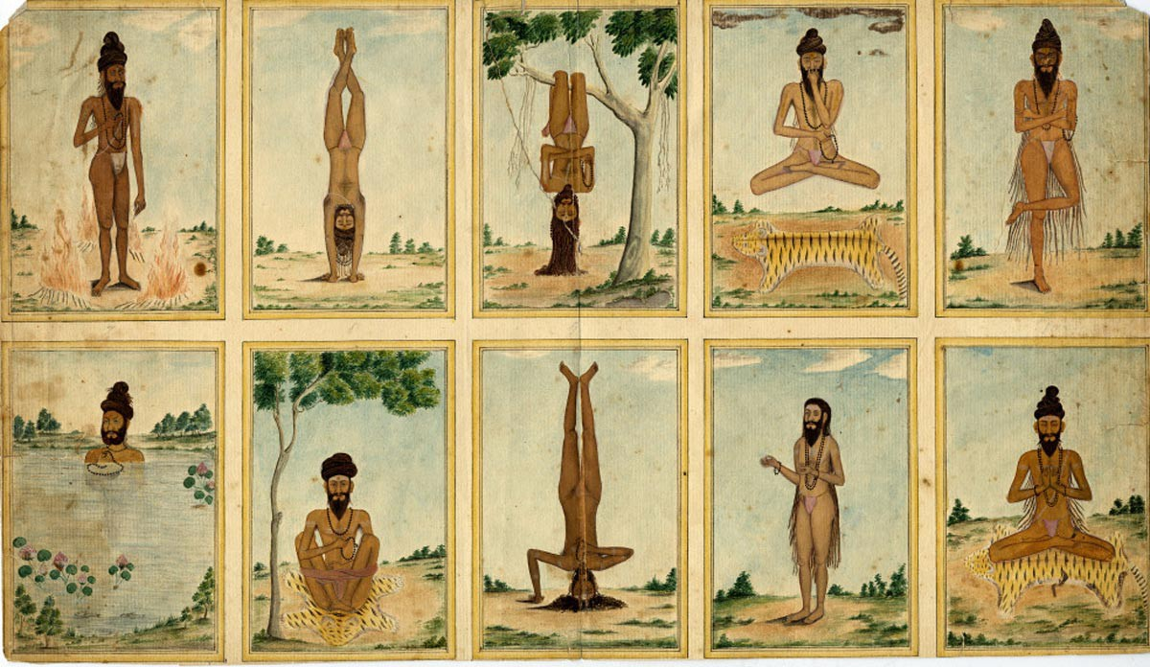
Advantages of Yoga
Yoga is growing more popular in the work place as the increased benefits of a regular yoga practice are becoming apparent for the increased number of participants.
The latest scientific research has proven the healing benefits Yoga Provides.

Slide 6
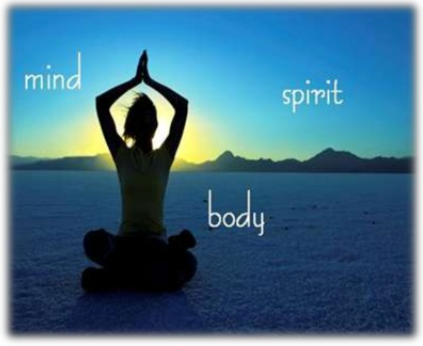
Yoga Purpose
The ultimate goal of Yoga is Moksha(liberation) through the exact definition of what form this takes depends on the philosophical or theological system with which it is conjugated.

Slide 7

Benefits of Yoga
Many studies have determined the effectiveness of Yoga as a complementary intervention for cancer, asthma and heart disease.

Slide 8
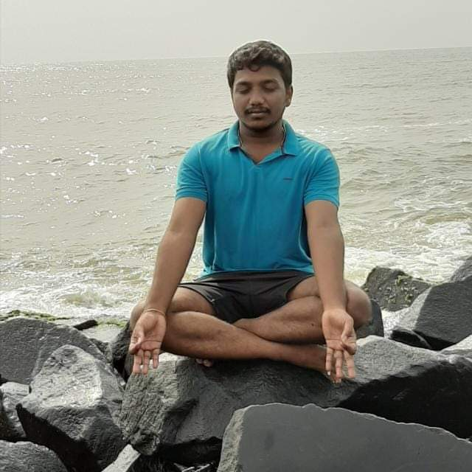
Yoga Techniques
There are different yoga techniques. The most common among are:
Surya Namaskar(Sun Salutation)
Meditation
Pranayama
Shatkarmas
Acupressure points

Slide 9
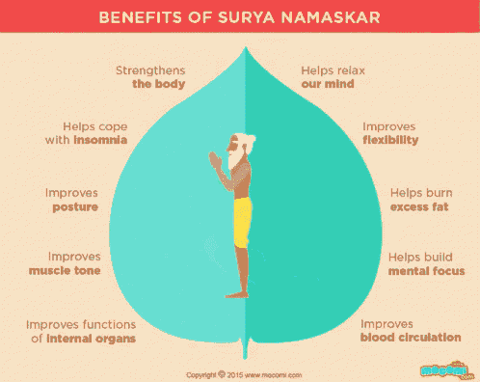
Yoga Technique(Surya Namaskar):
It is a salutation to the sun.
It is known to ease stress and give you peace of mind besides increasing your levels of concentration.

Slide 10

Yoga Techniques(Meditation)
Dhyana(Meditation):
It is the state of mind wherein there are no sensor thoughts.
It leads to a deeper level of relaxation, reduces anxiety, decreases muscle tension and headache.

Slide 11
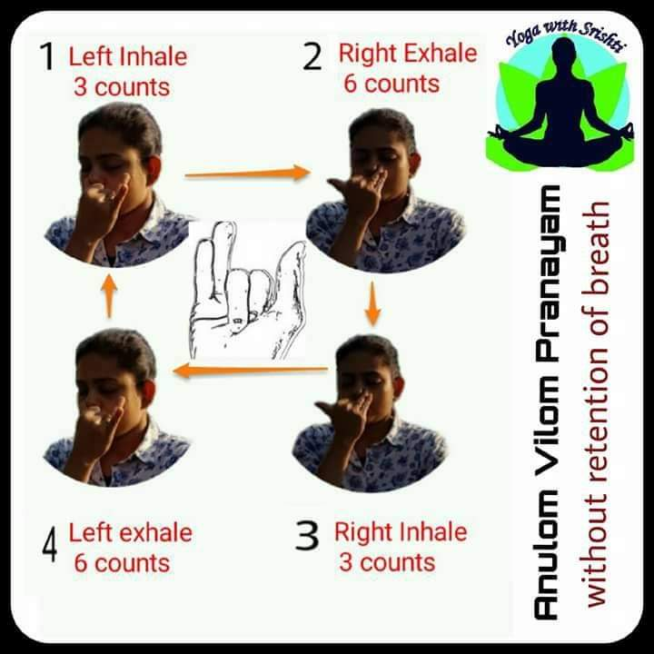
Yoga Technique(Pranayama)
Pranayama:
It means “a pause in the movement of breath”.
It increases the spiritual power and confers cheerfulness and inner peace.

Slide 12
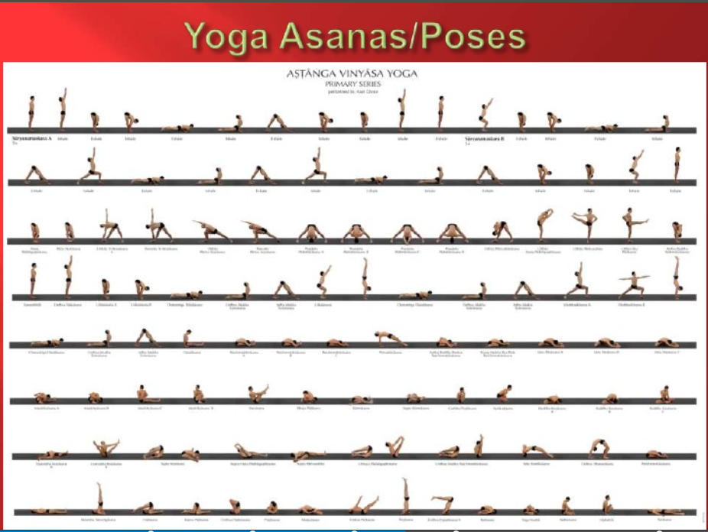
Asana(Body Posture)

Slide 13
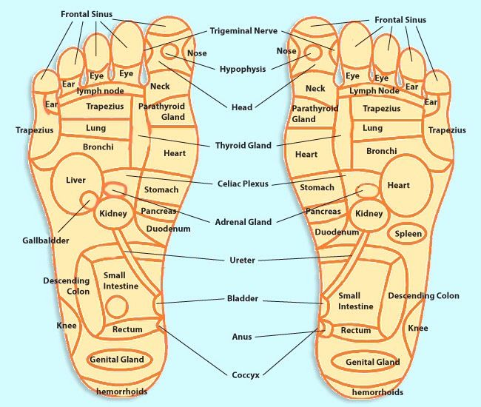
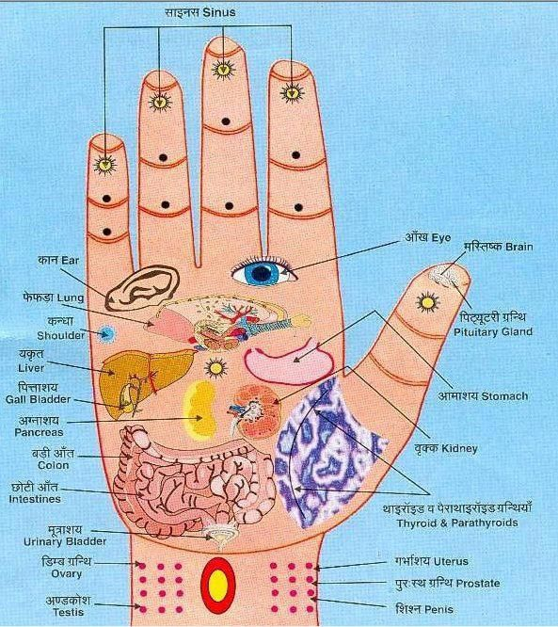
Accupressure points

Slide 14
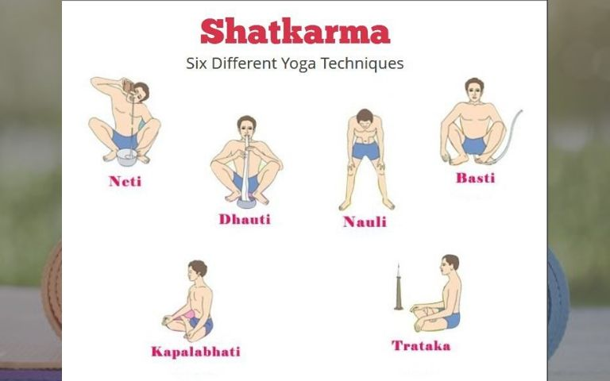
Shatkarmas(Six-Kriyas)

Slide 15
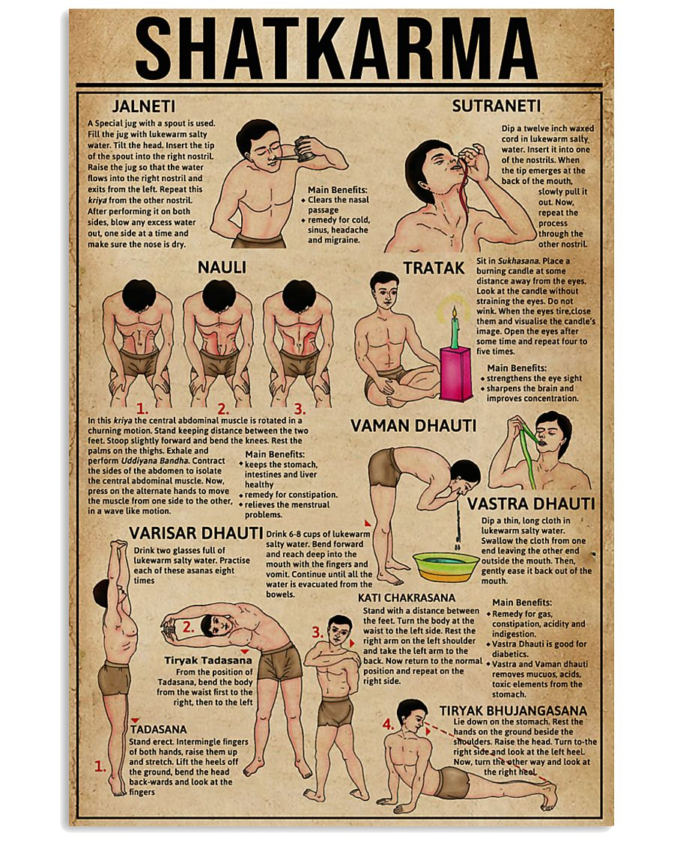
Shatkarmas:

Slide 16
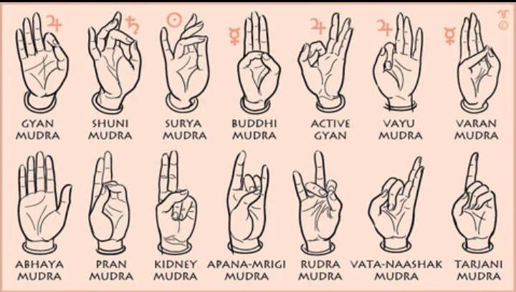
Mudhras

Slide 17

Any Queries

Slide 18

Thank You

